Slide 1
VPN

Slide 2
A virtual private network (VPN) extends a private network across a public network and enables users to send and receive data across shared or public networks as if their computing devices were directly connected to the private network. The benefits of a VPN include increases in functionality, security, and management of the private network. It provides access to resources that are inaccessible on the public network and is typically used for remote workers. Encryption is common, although not an inherent part of a VPN connection.
A VPN is created by establishing a virtual point-to-point connection through the use of dedicated circuits or with tunneling protocols over existing networks. A VPN available from the public Internet can provide some of the benefits of a wide area network (WAN). From a user perspective, the resources available within the private network can be accessed remotely.

Slide 3
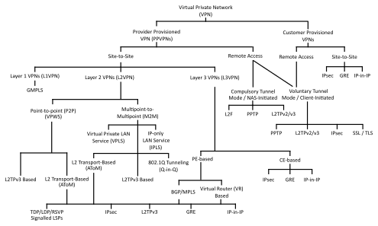
VPN classification tree based on the topology first, then on the technology used

Slide 4
Virtual private networks may be classified into several categories:
Remote access
A host-to-network configuration is analogous to connecting a computer to a local area network. This type provides access to an enterprise network, such as an intranet. This may be employed for remote workers who need access to private resources, or to enable a mobile worker to access important tools without exposing them to the public Internet.
Site-to-site
A site-to-site configuration connects two networks. This configuration expands a network across geographically disparate offices, or a group of offices to a data center installation. The interconnecting link may run over a dissimilar intermediate network, such as two IPv6 networks connected over an IPv4 network.[4]
Extranet-based site-to-site
In the context of site-to-site configurations, the terms intranet and extranet are used to describe two different use cases.[5] An intranet site-to-site VPN describes a configuration where the sites connected by the VPN belong to the same organization, whereas an extranet site-to-site VPN joins sites belonging to multiple organizations.
Typically, individuals interact with remote access VPNs, whereas businesses tend to make use of site-to-site connections for business-to-business, cloud computing, and branch office scenarios. Despite this, these technologies are not mutually exclusive and, in a significantly complex business network, may be combined to enable remote access to resources located at any given site, such as an ordering system that resides in a data center.
VPN systems also may be classified by:
The tunneling protocol used to tunnel the traffic
The tunnel's termination point location, e.g., on the customer edge or network-provider edge
The type of topology of connections, such as site-to-site or network-to-network
The levels of security provided
The OSI layer they present to the connecting network, such as Layer 2 circuits or Layer 3 network connectivity
The number of simultaneous connections

Slide 5
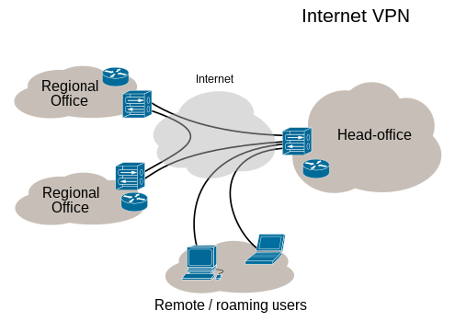
VPN connectivity overview, showing intranet site-to-site and remote-work configurations used together

